Slide 1
Unit-1
Chapter 1: Model Tuning

Slide 2
Chapter Contents
Data cleaning
Handling text and categorical attributes
Auto encoding
Label encoding
Custom transformers
Feature scaling
Transformation pipelines
Cross validation
Tuning a model using GridSearchcv, RandomizedSearchCV Ensemble methods

Slide 3
Data Cleaning
Data cleaning is an important step in machine learning, where the goal is to improve the quality of data that is being used for training a model. The process of data cleaning involves removing or correcting errors, inconsistencies, and outliers in the data, as well as dealing with missing values.
Handling missing values: One of the most common problems in real-world datasets is missing data. The presence of missing data can affect the accuracy of the model. There are different methods to handle missing values, such as imputation, deletion, or using models that can handle missing data.
Removing duplicates: Duplicate records can create bias and reduce the performance of the model. It is important to identify and remove any duplicate records from the dataset.
Removing outliers: Outliers are data points that lie far away from the majority of the data points. They can negatively impact the performance of the model. It is important to identify and remove outliers or use models that are robust to outliers.
Encoding categorical data: Machine learning models work with numerical data, so categorical data must be encoded before it can be used. One-hot encoding or label encoding are common techniques to encode categorical data.
Handling inconsistencies: Inconsistencies in the data can arise from human error or system errors. It is important to identify and correct any inconsistencies in the data before using it to train the model.

Slide 4
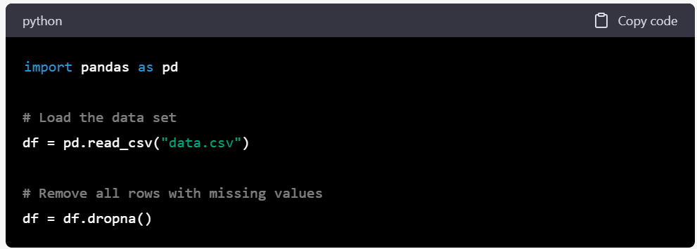
Handling Missing values
Handling missing values in a dataset involves methods for filling in the missing data so that the data can be used for analysis. Some common methods for handling missing values are:
Deletion: This method involves removing all observations with missing values. This method is simple but may lead to a significant loss of data if many observations are missing. For example, if a data set has 1000 observations, but 100 of them have missing values, then deletion would result in only 900 observations being used for analysis.

Slide 5
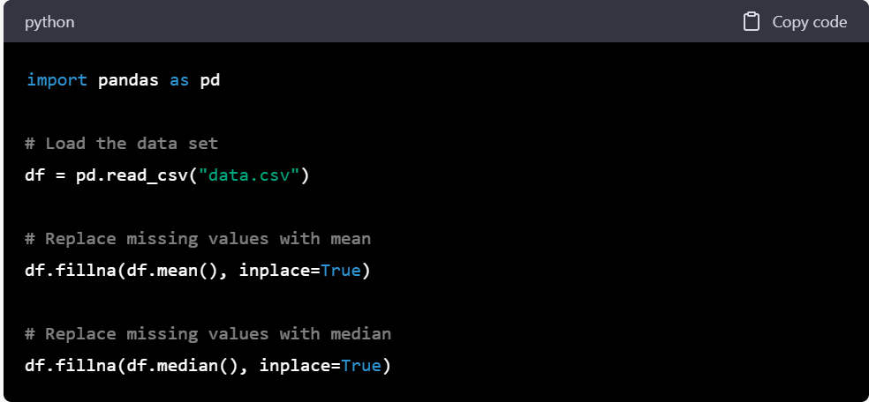
Mean/Median Imputation: This method involves replacing missing values with the mean or median of the variable. For example, if a data set has a column for age, and some observations have missing values, the missing values could be filled in with the mean or median age for the entire data set.

Slide 6
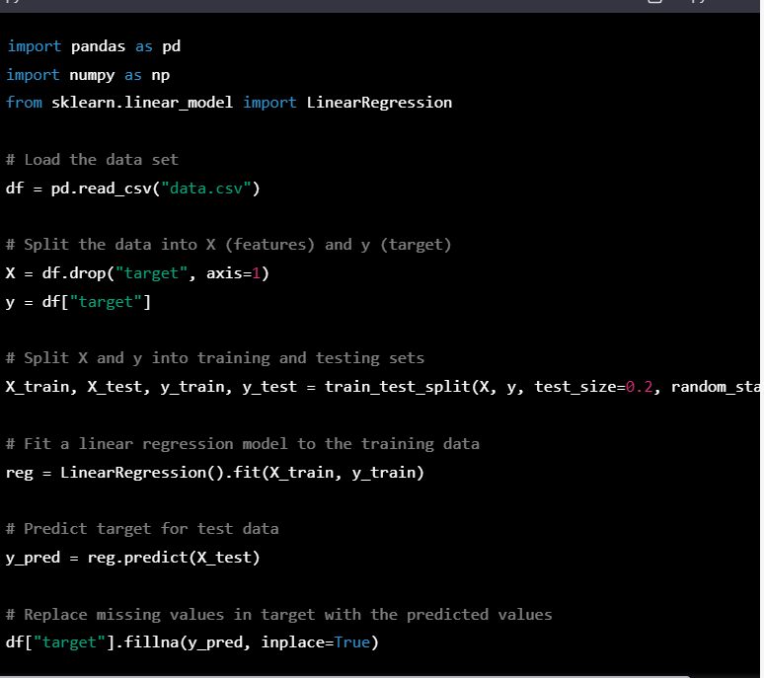
Regression Imputation: This method involves replacing missing values with the predicted values from a regression model. For example, if a data set has variables for height and weight, and some observations have missing values for weight, a linear regression model could be used to predict weight based on height, and the missing values could be filled in with the predicted values.

Slide 7
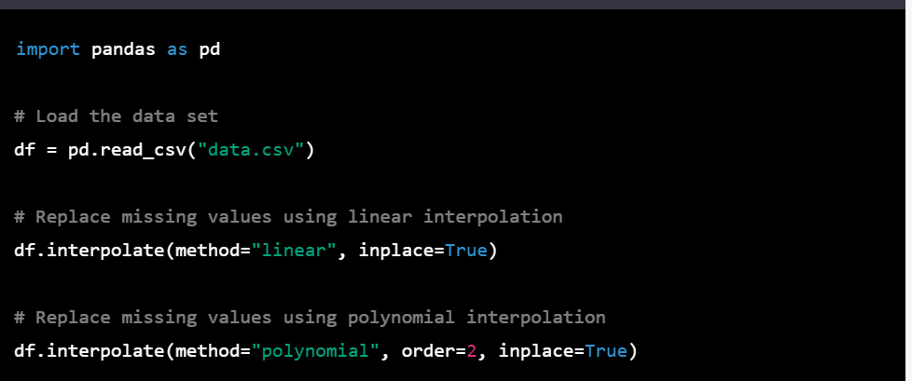
Interpolation: This method involves filling in the missing values using interpolation techniques, such as linear interpolation or polynomial interpolation. For example, if a data set has a column for temperature, and some observations have missing values, the missing values could be filled in by estimating temperature based on the temperatures at surrounding observations.

Slide 8
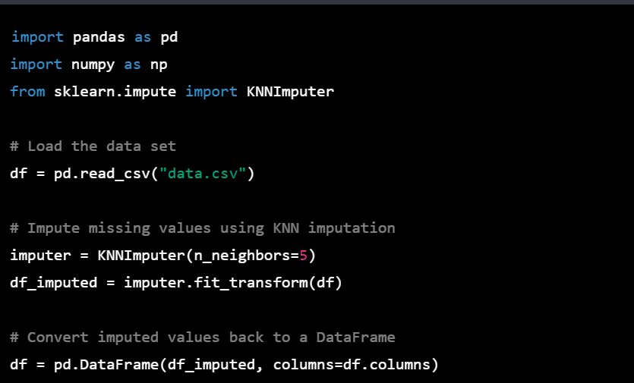
Multiple Imputation: This method involves replacing missing values with multiple estimates, and then combining the results to account for uncertainty. For example, if a data set has a column for income, and some observations have missing values, multiple imputation would involve estimating income based on other variables, generating several different datasets with different estimates for the missing values, and then combining the results to account for the uncertainty in the estimates.

Slide 9
Handling text and categorical attributes
Handling text and categorical attributes is important in many machine learning tasks, as these attributes are often non-numeric and can't be used directly in mathematical models. Here are some common methods for handling text and categorical attributes:
Label Encoding: This method involves converting each unique category into a numeric value. For example, if a data set has a column for "color" with categories "red", "green", and "blue", label encoding would convert these categories into numeric values such as 0, 1, and 2.
One-Hot Encoding: This method involves converting each category into a binary vector, with each element in the vector indicating the presence or absence of a particular category. For example, if a data set has a column for "color" with categories "red", "green", and "blue", one-hot encoding would convert this column into three separate columns, each indicating whether the observation is red, green, or blue.
Word Embeddings: This method involves converting words into dense vectors that capture semantic meaning. Word embeddings can be used to convert text data into numerical data that can be used in machine learning models. For example, if a data set has a column for "reviews" with text data, word embeddings could be used to convert each review into a numerical vector that captures the meaning of the review.

Slide 10
Examples-Label Encoding
from sklearn.preprocessing import LabelEncoder
# create example data
data = ['red', 'green', 'blue', 'green', 'red']
# create label encoder object
le = LabelEncoder()
# fit and transform the data
encoded_data = le.fit_transform(data)
print(encoded_data)
# output: [2 1 0 1 2]

Slide 11
Examples-OneHot Encoding
import pandas as pd
from sklearn.preprocessing import OneHotEncoder
# create example DataFrame
df = pd.DataFrame({'color': ['red', 'green', 'blue', 'green', 'red']})
# create one-hot encoder object
ohe = OneHotEncoder()
# fit and transform the data
encoded_data = ohe.fit_transform(df[['color']])
# create new DataFrame with encoded data
encoded_df = pd.DataFrame(encoded_data.toarray(), columns=ohe.get_feature_names(['color']))
print(encoded_df)
# output: color_blue color_green color_red
# 0.0 0.0 1.0
# 0.0 1.0 0.0
# 1.0 0.0 0.0
# 0.0 1.0 0.0
# 0.0 0.0 1.0

Slide 12
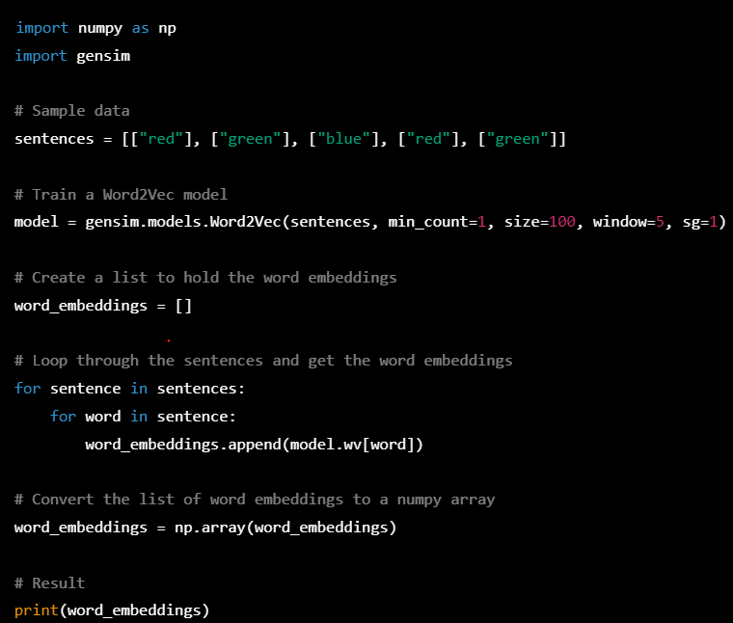
Examples-Word Embedding

Slide 13
Custom transformers
One of the most powerful features of scikit-learn is its ability to create custom transformers that can be seamlessly integrated into a machine learning pipeline.
In scikit-learn, a transformer is an object that transforms data from one representation to another. A transformer typically has a fit method that learns parameters from the training data, and a transform method that applies the learned transformation to new data.
Custom transformers allow you to define your own transformations that are specific to your data and problem domain.

Slide 14
To create a custom transformer in scikit-learn, you need to define a class that implements two methods: fit and transform. The fit method is used to learn any necessary parameters from the training data, while the transform method applies the learned transformation to new data.
If you want your transformer to be able to learn parameters from new data (e.g., in a cross-validation setting), you can also implement a fit_transform method that combines the fit and transform methods.
Here is an example of a custom transformer that scales the features of a dataset using the standardization technique

Slide 15
from sklearn.base import BaseEstimator, TransformerMixin
from sklearn.preprocessing import StandardScaler
class StandardizeTransformer(BaseEstimator, TransformerMixin):
def __init__(self):
self.scaler = StandardScaler()
def fit(self, X, y=None):
self.scaler.fit(X)
return self
def transform(self, X, y=None):
return self.scaler.transform(X)

Slide 16
In this example, the StandardizeTransformer class inherits from two base classes: BaseEstimator and TransformerMixin. The BaseEstimator class provides default implementations for methods such as get_params and set_params, while the TransformerMixin class provides a fit_transform method that combines the fit and transform methods.
The StandardizeTransformer class defines two methods: fit and transform. The fit method fits a StandardScaler object to the training data X, while the transform method applies the learned scaling to new data X.
Once you have defined your custom transformer, you can use it in a scikit-learn pipeline along with other transformers and a machine learning model. For example, you can use the StandardizeTransformer in a pipeline to preprocess the data before training a linear regression model:

Slide 17
from sklearn.pipeline import make_pipeline
from sklearn.linear_model import LinearRegression
pipeline = make_pipeline(StandardizeTransformer(), LinearRegression())
pipeline.fit(X_train, y_train)
In this example, the make_pipeline function creates a pipeline that first applies the StandardizeTransformer to the data, and then trains a LinearRegression model on the transformed data.

Slide 18
Feature Scaling
One of the most important transformations you need to apply to your data is feature scaling.
There are two common ways to get all attributes to have the same scale: min-max scaling and standardization.

Slide 19
Min-max scaling
Min-max scaling, also known as feature scaling or normalization, is a common data preprocessing technique used in machine learning to transform the features of a dataset into a common range. It involves rescaling the data to a fixed range of values, usually between 0 and 1, so that the features have a similar scale and do not affect the learning algorithm in different ways.
The min-max scaling formula for a feature x is as follows:
x_scaled = (x - x_min) / (x_max - x_min)
Where x is the original value
x_min : Minimum value of the feature
x_max: maximum value of the feature
Min-max scaling is particularly useful when the distribution of a feature is skewed or when the range of values is different for different features. It can help to improve the performance of machine learning algorithms, especially those that are sensitive to the scale of the input features, such as k-nearest neighbors and support vector machines.

Slide 20
from sklearn.preprocessing import MinMaxScaler
import numpy as np
# create a sample dataset
X = np.array([[1, 2, 3], [4, 5, 6], [7, 8, 9]])
# create a MinMaxScaler object
scaler = MinMaxScaler()
# fit and transform the data
X_scaled = scaler.fit_transform(X)
print(X_scaled)

Slide 21
Standardization
Standardization scaling, also known as Z-score normalization or standard scaling, is a data preprocessing technique used in machine learning to transform the features of a dataset so that they have zero mean and unit variance.
The standardization formula for a feature x is as follows:
x_scaled = (x - mean) / standard_deviation
Where
x: the original feature value
mean: is the mean of the feature
Standard_deviation: is the standard_deviation of the feature

Slide 22
import pandas as pd
from sklearn.preprocessing import StandardScaler
# load the data into a pandas DataFrame
df = pd.read_csv('your_data_file.csv')
# extract the feature columns you want to scale
feature_cols = ['col1', 'col2', 'col3']
# create a StandardScaler object
scaler = StandardScaler()
# fit and transform the selected features
df[feature_cols] = scaler.fit_transform(df[feature_cols])
# save the scaled DataFrame to a new CSV file
df.to_csv('standardized_data_file.csv', index=False)

Slide 23
Transformation pipelines
Data transformers are a set of techniques used in data preprocessing to transform raw data into a format that is suitable for machine learning algorithms. These techniques can include tasks such as scaling, encoding, feature selection, and feature engineering. Transformer pipelines are a way of combining multiple data transformers into a single pipeline that can be applied to input data.
The process of data transformers typically involves the following steps:
Data cleaning: This step involves removing any missing or erroneous data, such as incomplete or inconsistent records.
Data scaling: This step involves scaling numerical data to a common range, such as between 0 and 1, to avoid numerical instability.
Data encoding: This step involves converting categorical variables into numerical variables, such as using one-hot encoding or label encoding.
Feature selection: This step involves selecting the most relevant features for the task at hand, such as using correlation analysis or principal component analysis.
Feature engineering: This step involves creating new features from the existing data, such as using polynomial features or creating interaction terms.

Slide 24
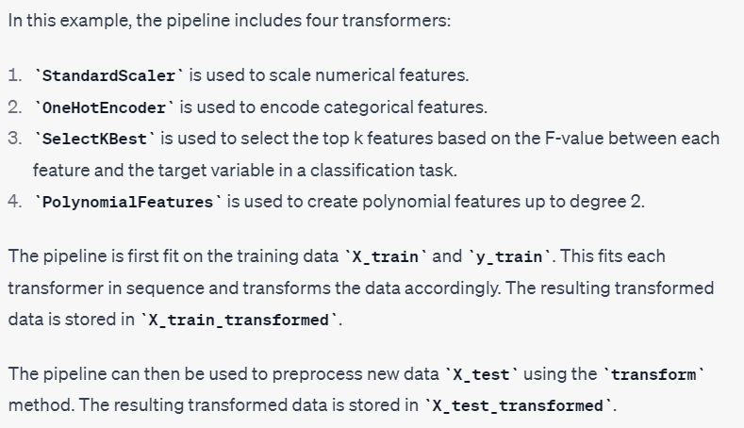
Pipeline –Data transformer
from sklearn.pipeline import Pipeline
from sklearn.preprocessing import StandardScaler, OneHotEncoder, PolynomialFeatures
from sklearn.feature_selection import SelectKBest, f_classif
# Define the pipeline with each transformer in sequence
pipeline = Pipeline([
('scaler', StandardScaler()),
('encoder', OneHotEncoder()),
('selector', SelectKBest(score_func=f_classif, k=10)),
('poly', PolynomialFeatures(degree=2))
])
# Fit the pipeline on training data
X_train_transformed = pipeline.fit_transform(X_train, y_train)
# Use the pipeline to preprocess new data
X_test_transformed = pipeline.transform(X_test)

Slide 25
Cross validation
Cross-validation is a common technique used for evaluating machine learning models. It involves dividing a dataset into multiple subsets, or "folds," and training the model on each fold while using the remaining folds for validation
The process is repeated for each fold, and the results are averaged to produce a final evaluation of the model's performance.
Here are the steps to perform cross-validation for model evaluation:
Split the dataset into k-folds, where k is typically 5 or 10.
For each fold i, train the model on all the other folds except for i.
Evaluate the model on the remaining fold i.
Repeat steps 2-3 for all k folds.
Calculate the average performance across all k evaluations to obtain a final estimate of the model's performance.

Slide 26
from sklearn.model_selection import cross_val_score
from sklearn.tree import DecisionTreeClassifier
from sklearn.datasets import load_iris
# Load iris dataset
iris = load_iris()
X = iris.data
y = iris.target
# Create a decision tree classifier
clf = DecisionTreeClassifier()
# Perform 5-fold cross-validation and compute the mean accuracy
scores = cross_val_score(clf, X, y, cv=5)
mean_accuracy = scores.mean()
print("Mean accuracy:", mean_accuracy)
In this example, we loaded the iris dataset and created a DecisionTreeClassifier model. We then used the cross_val_score function to perform 5-fold cross-validation, passing in the model, the dataset, and the number of folds (cv=5). The function returns an array of scores, one for each fold, which we then averaged to obtain the mean accuracy across all folds.

Slide 27
Tuning a Model
Model tuning is the process of selecting the best hyperparameters for a machine learning model to improve its performance on a given task. Hyperparameters are parameters that are not learned during the training process, but rather are set by the user before training.
Examples of hyperparameters include the learning rate of a neural network, the number of trees in a random forest, or the regularization parameter in a linear regression model.
GridSearchCV is a popular method for hyperparameter tuning that involves systematically searching through a specified grid of hyperparameters and evaluating the model's performance on a validation set for each combination of hyperparameters
The algorithm then selects the hyperparameters that produced the best performance, based on a specified scoring metric.

Slide 28
Gridsearchcv-hyperparameter tuning
from sklearn.model_selection import GridSearchCV
from sklearn.tree import DecisionTreeClassifier
from sklearn.datasets import load_iris
# Load iris dataset
iris = load_iris()
X = iris.data
y = iris.target
# Create a Decision Tree classifier
dtc = DecisionTreeClassifier()
# Define the hyperparameter grid to search over
param_grid = {'criterion': ['gini', 'entropy'],
'max_depth': [3, 4, 5, 6],
'min_samples_split': [2, 3, 4, 5],
'min_samples_leaf': [1, 2, 3, 4]}
# Perform grid search with 5-fold cross-validation and the accuracy score as the scoring metric
grid_search = GridSearchCV(dtc, param_grid, cv=5, scoring='accuracy')
grid_search.fit(X, y)
# Print the best hyperparameters and the corresponding accuracy score
print("Best hyperparameters:", grid_search.best_params_)
print("Best accuracy score:", grid_search.best_score_)

Slide 29
Randomizedsearchcv
The grid search approach is fine when you are exploring relatively few combinations, like in the previous example, but when the hyperparameter search space is large, it is often preferable to use RandomizedSearchCV instead.
This class can be used in much the same way as the GridSearchCV class, but instead of trying out all possible combinations, it evaluates a given number of random combinations by selecting a random value for each hyperparameter at every iteration
This approach has two main benefits:
If you let the randomized search run for, say, 1,000 iterations, this approach will explore 1,000 different values for each hyperparameter (instead of just a few values per hyperparameter with the grid search approach).
You have more control over the computing budget you want to allocate to hyper‐ parameter search, simply by setting the number of iterations

Slide 30
from sklearn.model_selection import RandomizedSearchCV
from sklearn.ensemble import RandomForestClassifier
from sklearn.datasets import load_iris
import numpy as np
# Load iris dataset
iris = load_iris()
X = iris.data
y = iris.target
# Create a Random Forest classifier
rfc = RandomForestClassifier()
# Define the hyperparameter distribution to sample from
param_dist = {'n_estimators': [100, 200, 300, 400, 500],
'max_depth': [3, 5, 7, 9, 11, 13, 15, None],
'min_samples_split': [2, 3, 4, 5, 6, 7, 8, 9, 10],
'min_samples_leaf': [1, 2, 3, 4, 5, 6, 7, 8, 9, 10],
'bootstrap': [True, False],
'criterion': ['gini', 'entropy']}
# Perform randomized search with 5-fold cross-validation and the accuracy score as the scoring metric
random_search = RandomizedSearchCV(rfc, param_distributions=param_dist, n_iter=100, cv=5, scoring='accuracy', random_state=42)
random_search.fit(X, y)
# Print the best hyperparameters and the corresponding accuracy score
print("Best hyperparameters:", random_search.best_params_)
print("Best accuracy score:", random_search.best_score_)

Slide 31
Ensemble methods
One of the advantages of ensemble methods is that they can often produce better results than a single model, especially if the individual models in the ensemble are diverse and complementary to each other.
Steps:
Choose the type of ensemble method that you want to use. Some common types of ensemble methods include:
Bagging: Build multiple models independently on random subsets of the training data and aggregate their predictions.
Boosting: Build models sequentially on the training data, with each subsequent model focusing on the samples that the previous models misclassified.
Stacking: Build multiple models independently on the training data and use their predictions as input to a higher-level model.

Slide 32
Select a base model that you want to use as a building block for the ensemble. For example, you could choose a Decision Tree classifier as your base model.
Define the hyperparameters that you want to tune for the base model. For example, you could tune the max_depth, min_samples_split, and min_samples_leaf hyperparameters.
Use GridSearchCV or RandomizedSearchCV to search over the hyperparameters for the base model, using cross-validation to evaluate the performance of each hyperparameter setting.
Once you have found the best hyperparameters for the base model, use them to train the base model on the full training data.
Use the trained base model to build the ensemble. For example, if you are using bagging, you could train multiple instances of the base model on random subsets of the training data, and then aggregate their predictions by taking the majority vote.
Use GridSearchCV or RandomizedSearchCV to search over the hyperparameters for the ensemble method, using cross-validation to evaluate the performance of each hyperparameter setting.
Once you have found the best hyperparameters for the ensemble method, use them to train the final ensemble on the full training data.
Evaluate the performance of the final ensemble on a holdout dataset to estimate its generalization performance.

Slide 33
from sklearn.ensemble import RandomForestClassifier
from sklearn.model_selection import GridSearchCV, cross_val_score
from sklearn.datasets import make_classification
# Generate a toy dataset
X, y = make_classification(n_samples=1000, n_features=10, n_informative=5, random_state=42)
# Define the hyperparameter grid to search over
param_grid = {
'n_estimators': [100, 200, 300],
'max_depth': [5, 10, None],
'max_features': ['sqrt', 'log2', 0.5],
'min_samples_split': [2, 5, 10],
'min_samples_leaf': [1, 2, 4]
}
# Create a random forest classifier
rf = RandomForestClassifier(random_state=42)
# Perform grid search with 5-fold cross-validation
grid_search = GridSearchCV(estimator=rf, param_grid=param_grid, cv=5, scoring='accuracy')
grid_search.fit(X, y)
# Print the best hyperparameters and corresponding score
print(f"Best hyperparameters: {grid_search.best_params_}")
print(f"Best score: {grid_search.best_score_}")

Slide 34
Chapter 2: Shallow Algorithms

Slide 35
Contents
Logistic regression
Estimating Probabilities
Training and cost function
Decision boundaries
SoftMax regression
Non-linear SVM classification: Polynomial kernel
Adding similarity feature
Gaussian RBF Kernel
SVM Regression

Slide 36

Logistic Regression
Logistic Regression (also called Logit Regression) is commonly used to estimate the probability that an instance belongs to a particular class (e.g., what is the probability that this email is spam?). If the estimated probability is greater than 50%, then the model predicts that the instance belongs to that class (called the positive class, labeled “1”), or else it predicts that it does not (i.e., it belongs to the negative class, labeled “0”). This makes it a binary classifier.
Estimating Probabilities:
A Logistic Regression model computes a weighted sum of the input features (plus a bias term), but instead of outputting the result directly like the Linear Regression model does, it outputs the logistic of this result
→ Equation for Logistic regression

Slide 37
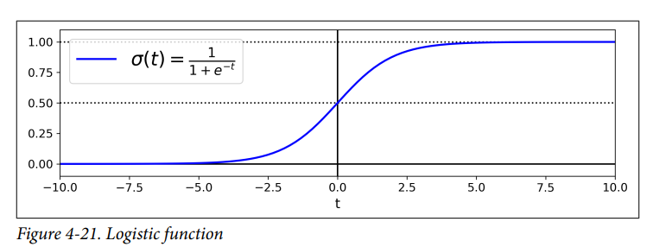
Logistic regression Function

Slide 38
Training and Cost Function
The training process for logistic regression involves finding the values of the model parameters that minimize the cost function. The cost function is a measure of how well the model fits the training data.
The most common cost function for logistic regression is the binary cross-entropy. The binary cross-entropy is a measure of the difference between the predicted probabilities and the actual labels.
The goal of the training process is to find the values of the model parameters that minimize the cost function. This is done using an iterative algorithm, such as gradient descent.
Once the model is trained, it can be used to predict the probability of an event occurring for new data.

Slide 39
The training process in logistic regression involves two main components: the hypothesis function and the cost function.
1. Hypothesis Function: The hypothesis function in logistic regression models the probability of the positive class (e.g., class 1) given the input features. It uses a logistic (or sigmoid) function to squash the output between 0 and 1, representing a probability value. The hypothesis function is defined as:
hθ(x) = 1 / (1 + e^(-θ^T*x))
Here, hθ(x) is the predicted probability of the positive class, θ is a vector of model parameters (also known as weights or coefficients), and x is the vector of input features.
2. Cost Function: The cost function measures the error or discrepancy between the predicted probabilities and the actual binary labels in the training data. In logistic regression, the most commonly used cost function is the logistic loss (or binary cross-entropy) function. The cost function penalizes the model for incorrect predictions and encourages it to adjust the parameters in a way that minimizes the overall loss.
For a single training example (x, y), where y is the binary label, the logistic loss function is defined as:
C(θ) = -y*log(hθ(x)) - (1-y)*log(1-hθ(x))

Slide 40
Decision boundaries in logistic regression
In logistic regression, decision boundaries are the lines or surfaces that separate different classes in the input feature space. The decision boundary represents the point where the logistic regression model classifies an example as belonging to one class or another.
Since logistic regression is a binary classification algorithm, it typically divides the input feature space into two regions corresponding to the two classes. The decision boundary can take different forms depending on the complexity of the data and the model's parameters.
In some cases, it may be impossible to find a single straight line that separates the classes. In such cases, non-linear decision boundaries are used.
The process of determining decision boundaries involves a mathematical technique called optimization, which involves finding the minimum or maximum value of a given function.

Slide 41
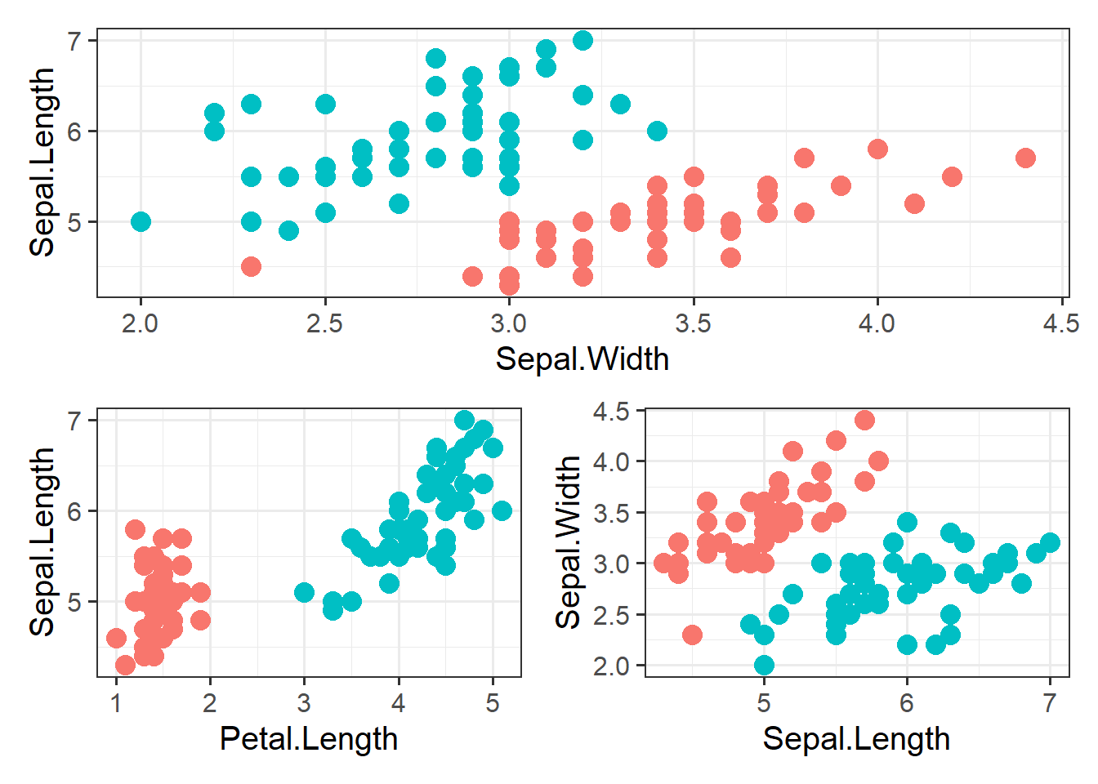

Slide 42

Softmax Regression/Multinominal Logistic Regression
The Logistic Regression model can be generalized to support multiple classes directly, without having to train and combine multiple binary classifiers. This is called Softmax Regression, or Multinomial Logistic Regression
In softmax regression, we aim to assign an input example to one of K possible classes, where K is greater than 2. The output of the softmax regression model is a probability distribution over the K classes, indicating the likelihood of the input example belonging to each class.
The idea is quite simple: when given an instance x, the Softmax Regression model first computes a scores k(x) for each class k, then estimates the probability of each class by applying the somax function (also called the normalized exponential) to the scores

Slide 43
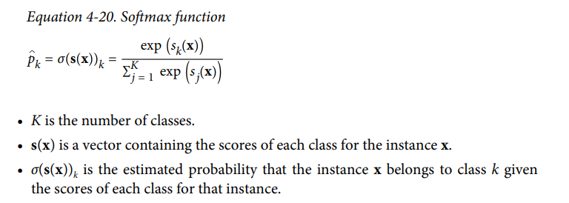
Once you have computed the score of every class for the instance x, you can estimate the probability pk that the instance belongs to class k by running the scores through the softmax function.
It computes the exponential of every score, then normalizes them (dividing by the sum of all the exponentials). The scores are generally called logits or log-odds (although they are actually unnormalized logodds).

Slide 44
Support Vector Machine
A Support Vector Machine (SVM) is a very powerful and versatile Machine Learning model, capable of performing linear or nonlinear classification, regression, and even outlier detection.
SVMs are particularly well suited for classification of complex but small- or medium-sized datasets.
Although linear SVM classifiers are efficient and work surprisingly well in many cases, many datasets are not even close to being linearly separable.
One approach to handling nonlinear datasets is to add more features, such as polynomial features; In some cases this can result in a linearly separable dataset. Consider the left plot in Figure 5-5: it represents a simple dataset with just one feature x1 . This dataset is not linearly separable, as you can see. But if you add a second feature x2 = (x1 ) 2 , the resulting 2D dataset is perfectly linearly separable

Slide 45
Adding polynomial feature
In this approach, we transform the original feature space by creating polynomial combinations of the input features. For example, if we have two input features x and y, we can add polynomial features such as x^2, xy, y^2, etc.
By including these polynomial features, we effectively increase the dimensionality of the data, allowing for a more complex decision boundary.
The SVM model can then be trained on this augmented feature space, where a linear separation may be possible.
The drawback of this approach is that the dimensionality of the feature space can grow rapidly, leading to increased computational requirements and potential overfitting if not properly regularized.

Slide 46
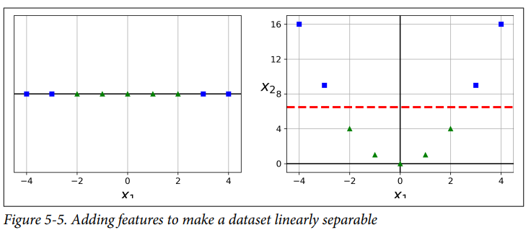
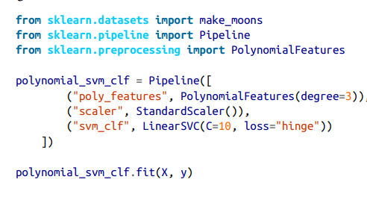
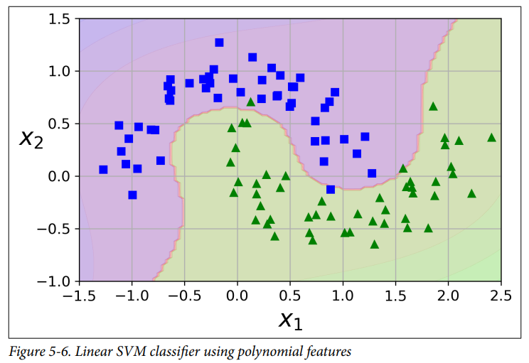
To implement this idea using Scikit-Learn, you can create a Pipeline containing a PolynomialFeatures transformer, followed by a StandardScaler and a LinearSVC.

Slide 47
Handling non-linear data using kernel functions
In SVMs, the goal is to find a hyperplane that separates the data points of different classes with the maximum margin. When the data is not linearly separable in the original feature space, SVMs employ the concept of kernel functions to project the data into a higher-dimensional space where linear separation becomes possible.
The key idea behind kernel functions is that they define a measure of similarity between pairs of data points. The kernel function calculates the inner product (dot product) between the feature vectors of two data points in either the original feature space or a transformed feature space.
Instead of explicitly expanding the feature space by adding polynomial combinations of the input features, kernel functions provide a way to implicitly represent the data in a higher-dimensional space. The transformed feature space is not explicitly computed, saving computational resources.
Kernels define a similarity measure between two points in the original input space or a transformed feature space.
Common kernel functions like the polynomial kernel, RBF kernel, and sigmoid kernel can capture complex relationships without explicitly adding polynomial features.
Kernels operate directly on the input data, and the transformed feature space is not explicitly computed, which avoids the dimensionality explosion problem.

Slide 48
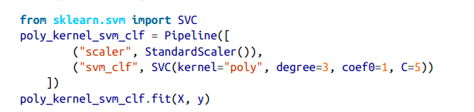
Polynomial Kernel
Fortunately, when using SVMs you can apply an almost miraculous mathematical technique called the kernel trick
It makes it possible to get the same result as if you added many polynomial features, even with very high degree polynomials, without actually having to add them. So there is no combinatorial explosion of the number of features since you don’t actually add any features

Slide 49
Polynomial Kernel and its function
Polynomial Kernel Function:
The polynomial kernel function is defined as K(x, y) = (γ * <x, y> + r)^d, where x and y represent the input feature vectors, <x, y> denotes the dot product between them, and d is the degree of the polynomial.
The dot product <x, y> captures the similarity or inner product between the feature vectors in the original feature space.
By raising the result of the dot product to the power of d and scaling it by the parameter γ, the polynomial kernel computes the similarity between two data points in a higher-dimensional space.

Slide 50
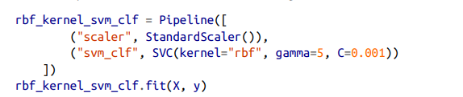
RBF Kernel (Radial Basis Function)/Gaussian RBF Kernel Function
Another technique to tackle nonlinear problems is to add features computed using a similarity function that measures how much each instance resembles a particular landmark.
RBF Kernel Function:
The RBF kernel function is defined as K(x, y) = exp(-γ * ||x - y||^2), where x and y represent the input feature vectors, ||x - y|| denotes the Euclidean distance between them, and γ is a hyperparameter that controls the spread of the kernel.
The RBF kernel computes the similarity between two data points based on the exponential of the negative squared distance between them.

Slide 51
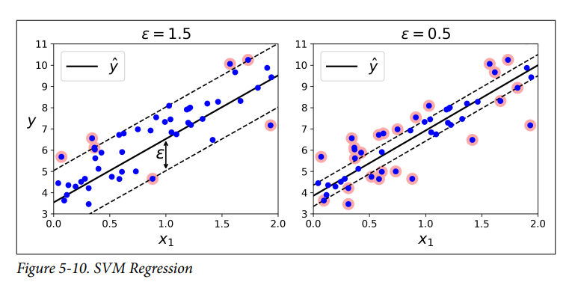
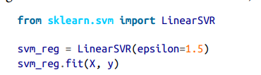
Support Vector machine for Regression
Support Vector Machines (SVMs) can also be used for regression tasks, in addition to classification tasks. Support Vector Machine Regression (SVR) is a supervised learning algorithm that aims to build a regression model by finding an optimal hyperplane that best fits the training data.
The trick is to reverse the objective: instead of trying to fit the largest pos‐ sible street between two classes while limiting margin violations, SVM Regression tries to fit as many instances as possible on the street while limiting margin violations

Slide 52
THANK YOU

